Slide 1
Recycled Water Discharge into Los Osos Creek

Slide 2
Background for Creek Discharge
Stream seepage from Los Osos Creek is a primary source of basin recharge
Creek alluvium flows into both the upper and lower aquifers
Creek discharge was planned as a primary method of effluent management in the late ‘80’s.
Creek discharge is not a part of the County’s current project, but could be considered as a water supply project
Discharge would be limited to periods of no stream flow – summer and fall

Slide 3
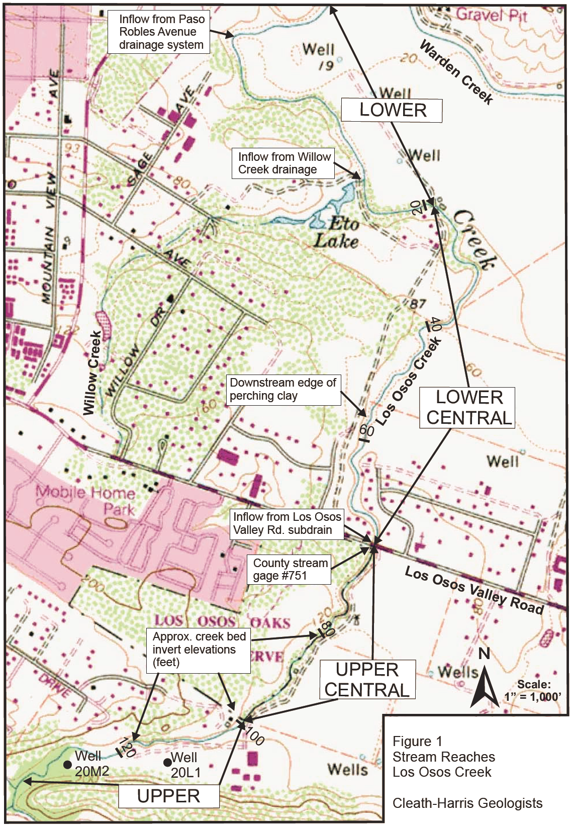
Upper and Upper Central Reaches of Los Osos Creek:
Highly permeable
Recharges lower aquifer
Able to accept over 1 million gallons per day during summer/fall

Slide 4
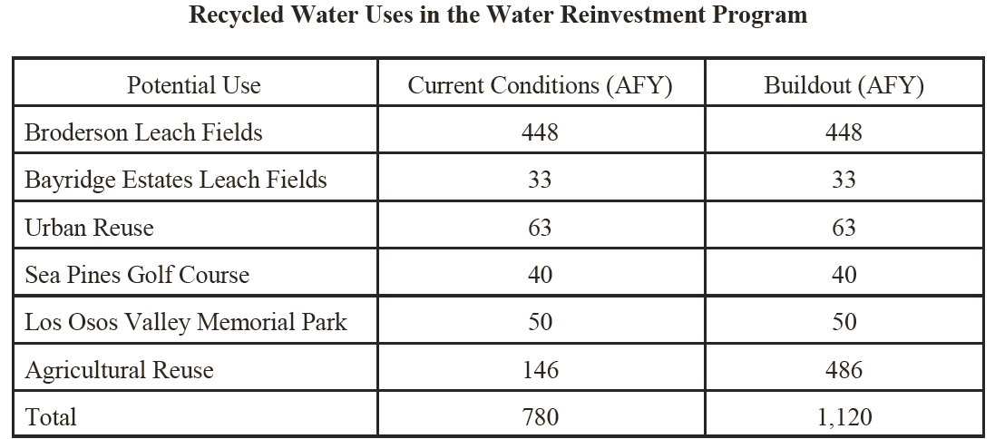

Slide 5
Potential for Water Supply Benefits
Broderson percolation, urban re-use, and ag reuse on existing irrigated crops are the most efficient uses of recycled water
Growers with existing basin water supplies have not yet signed contracts to received recycled water
Growers that are planning new crops without previous irrigation are pursuing recycled water (5 year contracts)
The irrigation of new crops does not provide any benefit to the basin in terms of yield or sea water intrusion reduction

Slide 6
Potential for Water Supply Benefits
Shifting irrigation of new crops to creek discharge would increase the basin yield
Yield would increase by 30 to 40% of the amount discharged to the creek
If spring water levels are used to calibrate the amount discharged, efficiency improves
Using all available strategies, yield could be increased by 60% to 90% of the amount discharged

Slide 7
Next Steps
NPDES permit requirements and water quality
Physical infrastructure for discharge is straightforward. Water quality enhancements would be more complex.
Cost/benefit given available water volumes
Coordination with Federal and State environmental agencies

Slide 8
Questions?

